Slide 1
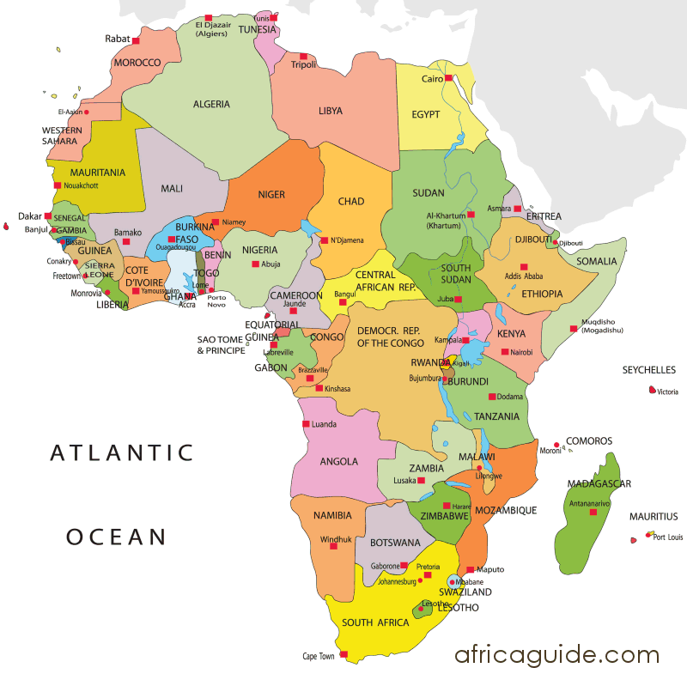
~ Africa - Africans ~ and the people of African Descent
Final Exam Presentation
Alicia Lindo HIST 374

Slide 2
Outline
Introduction
The Journey Then and Now: Ancient Abyssinia to Ethiopia -- Revised Midterm
The positive and negative influence of African inclusion within the African Diaspora
Human rights challenges
Recommendations/ Call to action
Conclusion

Slide 3
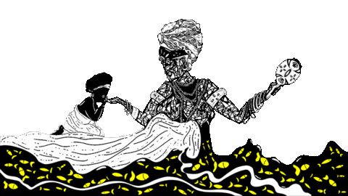
Introduction
Africa is full of rich history, significant contributions and unique resilience during historical challenges. Ethiopia's avoidance of European colonization due to its early Christian identity serves as a testament to the nation's strength and cultural distinctiveness. the enduring positive impact of the trans-Atlantic slave trade on the African diaspora, included the cultural, linguistic, and dietary transformations that occurred. The negative consequences, such as economic disparities and missed opportunities for development in Africa, underscores the lasting implications of historical injustices.

Slide 4
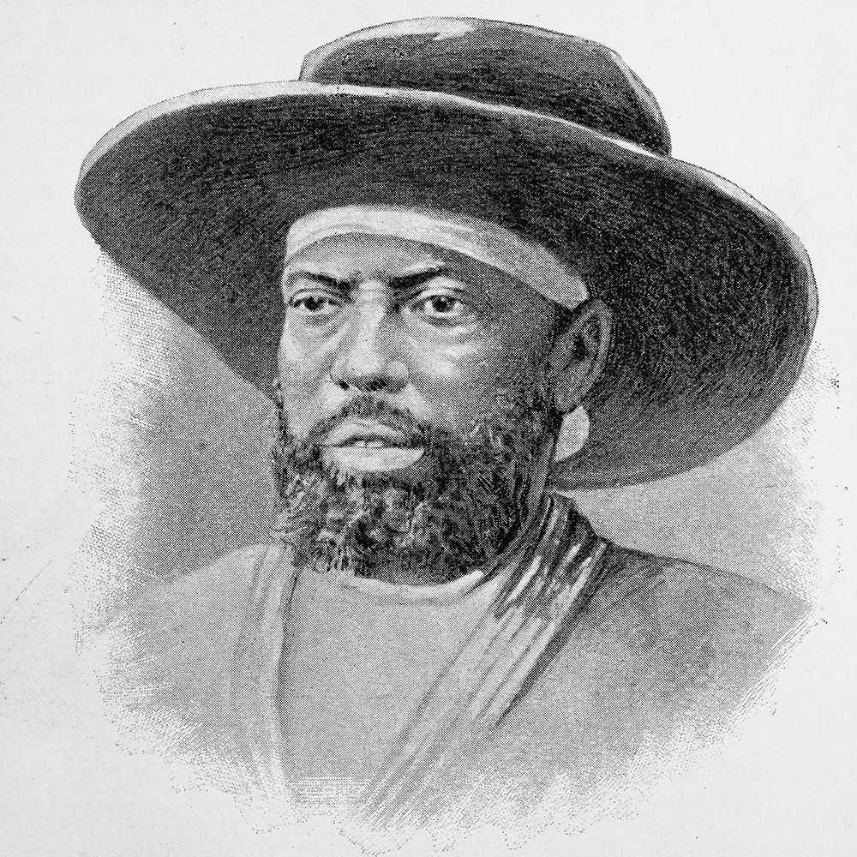
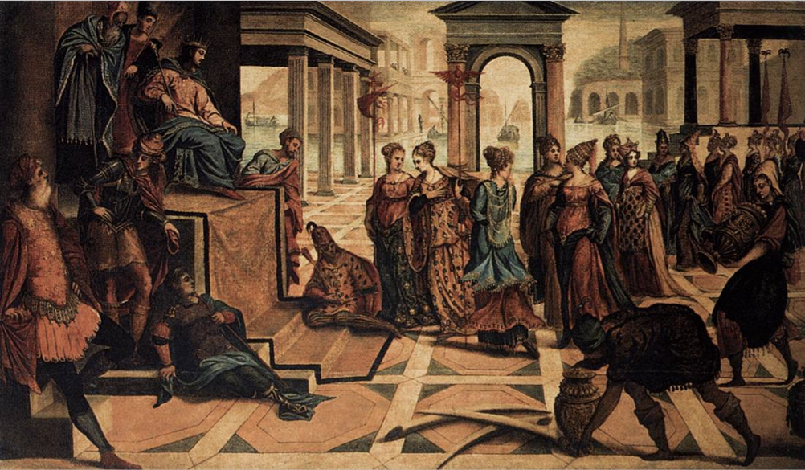
Ancient Abyssinia
Abyssinia, a thousand-year-old African nation, had resisted a drastically more developed modern army and became the first and only African nation to escape the clutches of European colonialism in Africa. This defeat shook the European world. This nation was very powerful and more self sustainable than people gave it credit for. During the Atlantic Slave Trade while other nations destabilized, depopulated, and unable to mount a strong resistance. Ethiopia, on the other hand, successfully staved off colonizers, becoming a symbol of African self-determination. Menelik II (depicted in the right picture) was accredited for aiding Ethiopian troops in the Battle of Adwa between Ethiopia and Italy.

Slide 5
Implications that plague the minds of Africans
Psychological Implications
Ignorance is one implication that has plagued the mind of Africans and people of African Descent. This implication has not only created an unrealistic bias of what it means to be African but it has also created an identity crisis of those that are African.
Economic Implications
One economic implication that affects Africans is the discrimination they face in many areas of the diaspora. Systematic Inequality: How America’s Structural Racism Helped Create the Black-White Wealth Gap” highlights the historical challenges faced by African Americans in the United States, beginning with slavery, which deprived them of the opportunity to build wealth and pass it on to future generations. Labor market discrimination and segregation are identified as persistent issues, pushing African Americans into fewer and less advantageous employment opportunities compared to their white counterparts. This leads to reduced access to stable jobs, google wages and retirement benefits, essential elements for building wealth

Slide 6
Effect of
African Influences
Africans brought to the Americas the greatly varied cultures of their homelands, including folklore, language, music, and foods. In forging new lives with one another, as well as neighboring Europeans and Native Americans, rich varieties of African diaspora culture took root in a New World decidedly shaped by the cultural innovations of Africans and their descendants.

Slide 7
“The Impact of Slavery on Modern Africa” discusses the negative consequences of the African diaspora, highlighting the detrimental impact of removing Africans from their native lands. It points out that taking men and women in their prime as slaves has not only affected historical economic activities but has also contributed to the persistent poverty in African countries. Researchers, such as Nunn, connect the majority of slaves being taken from certain countries to the ongoing poverty in those regions. The passage suggests that the removal of this labor force during the slave trade era has led to a 72 percent income gap between Africa and the rest of the world.
Effects of
African Influence
Harry Munendo a historian and lecturer at Department of History, Archeology and Political Studies of Kenyatta University in Kenya, says “Human capital from post slave trade was one of the most valued assets across African societies. Slaves were captured to go work in plantations in the Americas and Europe at the height of the agricultural revolution. Now you can imagine the difference this would have made to the economic development of the continent if these strong and energetic labor forces were allowed to develop their own farmlands and societies.”

Slide 8
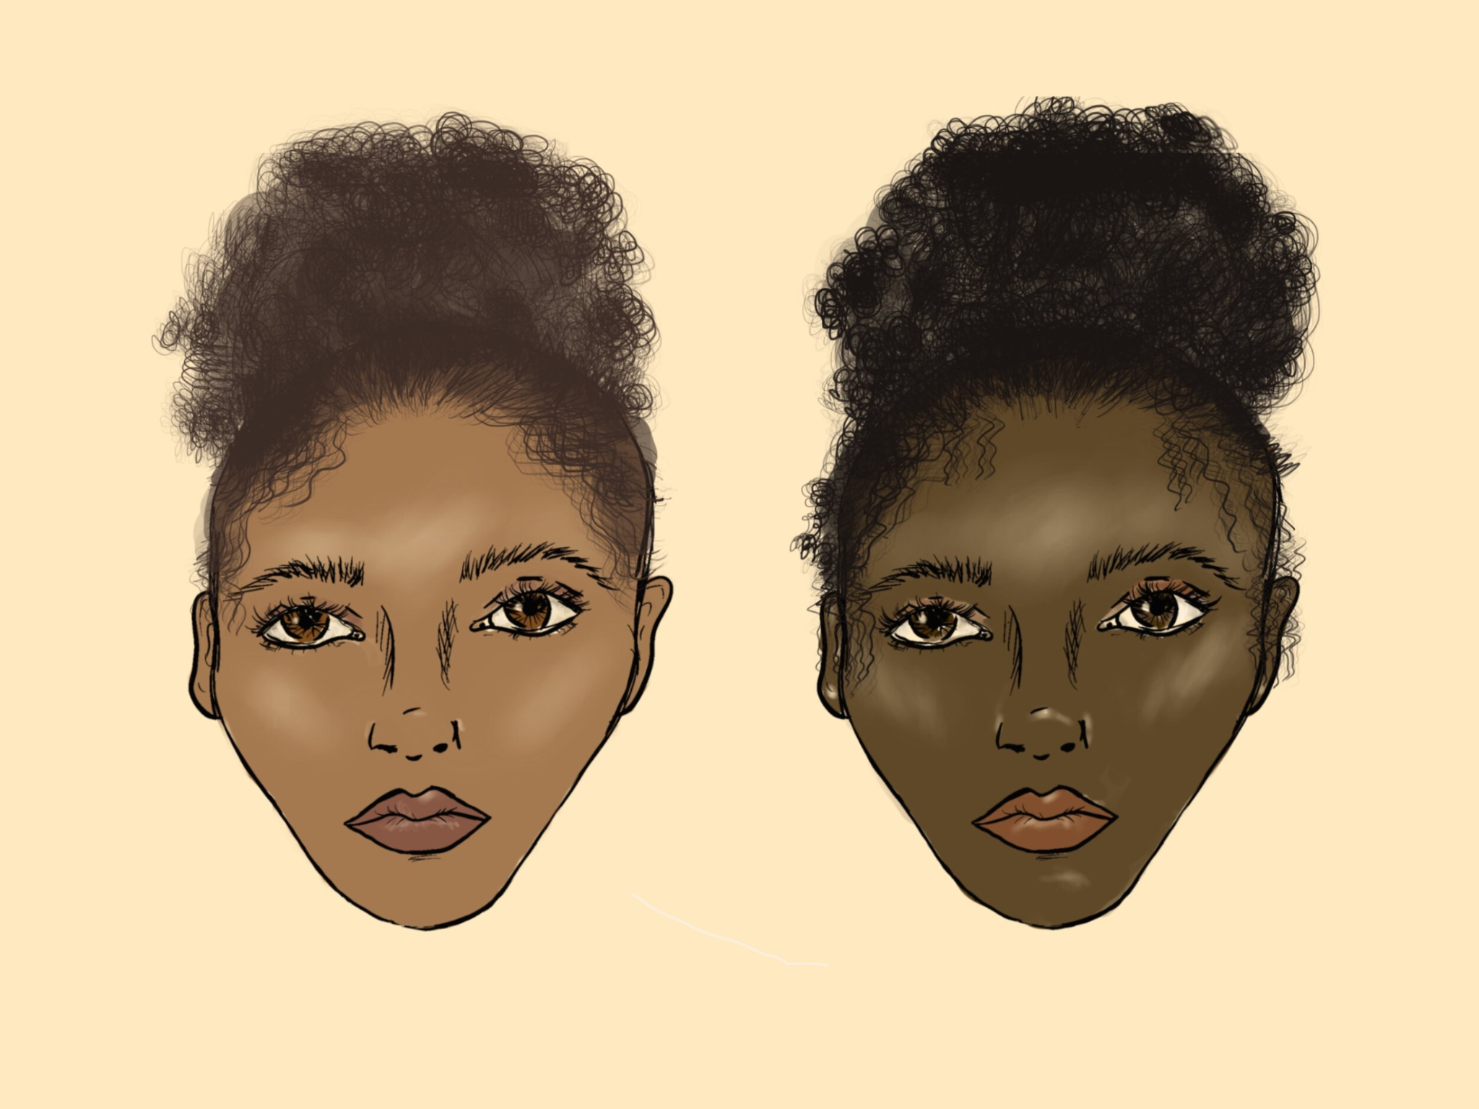
Human Rights Challenges: Colorism & Racism
One example of Human rights challenges is discrimination by race and skin tone. Discrimination affects individuals ability to go far in life as their opportunities can be limited.
For example, dark skinned African Americans mayu time getting in landing a job interview than light skinned African Americans. Initially, both groups may have been last picks because of their African descent but the discrimination now transforms from racism to colorism, where fairer skinned tones are mainly favored.

Slide 9
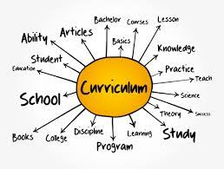
Human Rights Challenges: Education
Another challenge that is being faced is the absence of African history teaching within the curriculum. I have only been exposed to the teaching of African culture within higher education. This should not be the case given that history is a fundamental subject but the type of history that is being taught is only serving to showcase the victories of the Europeans. The ongoing dismissal of African American history in various states, including Florida and Texas, signifies a refusal to acknowledge the suppressed narratives in K-12 education. This rejection extends to the struggles of African Americans whose resistance prompted legal changes and constitutional amendments, revealing the incongruence between racism and national values. It overlooks the vital connection between the experiences of the 7.4 million Black students in public schools and the historical contributions of their ancestors, essential for understanding contemporary progress labeled as "American."

Slide 10
Rewriting History
It is merely impossible for Africans and people of African Descent to erase their vast history, however it is possible for them to rewrite their history. This will not only bring more awareness on the events and implications of the Trans Atlantic Slave Trade but also allow for future generations to be enlightened on the historical truth of Africas past.
One way they can rewrite their history is to first unlearn historical truth. This means unlearning all of the false narratives about Africa that have shed a negative light on the continent and sided with the Europeans.
Use proper language / eliminating offensive language that was meant to to discredit African development and diminish the quality of life within Africa. Ex: Tribe / tribal refers to wild and exotic, ex : “Stateless society” refers to lack of order
Learn African history through formal education

Slide 11
Recommendations/Call to Action
In addition, my call to action is my proactive approach to rewriting African history and dispelling false narratives. Education, particularly the incorporation of African history into formal curriculum and the perpetuation of oral storytelling, is a crucial strategy to counteract historical inaccuracies. It will be available to the future generations if myself and others share and document knowledge in order to delve into their heritage and challenge prevailing historical misconceptions. By fostering awareness, understanding, and a sense of collective responsibility, this allows for a step towards rectifying historical injustices and promoting a more accurate and inclusive narrative of Africa's past. Ultimately, this stands as a testament to the resilience and richness of African history and calls for a collective effort to honor, preserve, and celebrate this diverse heritage.

Slide 12
Works Cited
The Transatlantic Slave Trade. Equal Justice Initiative. (2023, June 20). https://eji.org/reports/transatlantic-slave-trade-overview/#:~:text=While%20many%20families%2C%20businesses%2C%20and,or%20honestly%20confronted%20this%20history.
Cambridge University Press. (2023, December 11). Writing African History. Retrieved from https://www.cambridge.org/core/books/writing-african-history/FB32EABC860F3200AE367888F9205353
Koigi, B(2023, December 11). Fair Planet. The impact of slavery on modern Africa. Retrieved from https://www.fairplanet.org/dossier/beyond-slavery/the-impact-of-slavery-on-modern-africa/#:~:text=The%20evidence%20suggests%20that%20it,and%20the%20practice%20of%20polygyny.
How Portuguese slave traders changed Ethiopia and Congo. (2023, December 11). https://daily.jstor.org/how-portuguese-slave-traders-changed-ethiopia-and-congo/
How Portuguese slave traders changed Ethiopia and Congo. (2023, December 11.). https://daily.jstor.org/how-portuguese-slave-traders-changed-ethiopia-and-congo/
Weller, C. E. (2018, February 21). Systematic inequality. Center for American Progress. https://www.americanprogress.org/article/systematic-inequality/
Washington, M. (2023, March 7). What the rejection of African American history means for students (opinion). Education Week. https://www.edweek.org/teaching-learning/opinion-what-the-rejection-of-african-american-history-means-for-students/2023/02
African Diaspora Culture. Slavery and Remembrance. (2023, October 8). https://slaveryandremembrance.org/articles/article/?id=A0057
Ethiopia geography. CountryReports. (2023, October 8). https://www.countryreports.org/country/Ethiopia/geography.htm

