Slide 1
The Trans-Atlantic Slave Trade
UCHECHUKWU OKONKWO

Slide 2
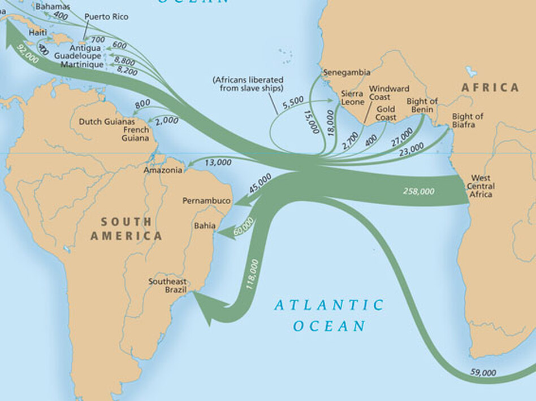
INTRODUCTION
The Transatlantic Slave Trade, active from the late 15th to the mid-19th century, was a tragic epoch in human history. It involved the mass forced migration of African people, primarily to the Americas. European traders captured or bought Africans, who were then transported across the Atlantic Ocean under brutal conditions.

Slide 3
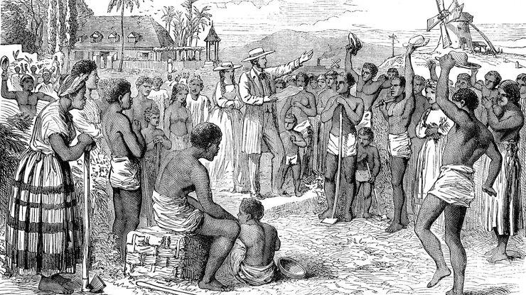
Origins and Causes
The origins of the Transatlantic Slave Trade are rooted in European colonial expansion and the demand for labor in the Americas. In the 15th century, as European powers like Portugal and Spain established colonies, they sought a workforce for their plantations and mines. Initially utilizing Indigenous peoples, they turned to Africa due to its proximity and existing slave trade networks. Economic factors, including the profitability of cash crops like sugar and tobacco, intensified this demand. Socially, racial ideologies began to justify slavery. African rulers and traders, driven by their own economic interests, participated in capturing and selling people,

Slide 4
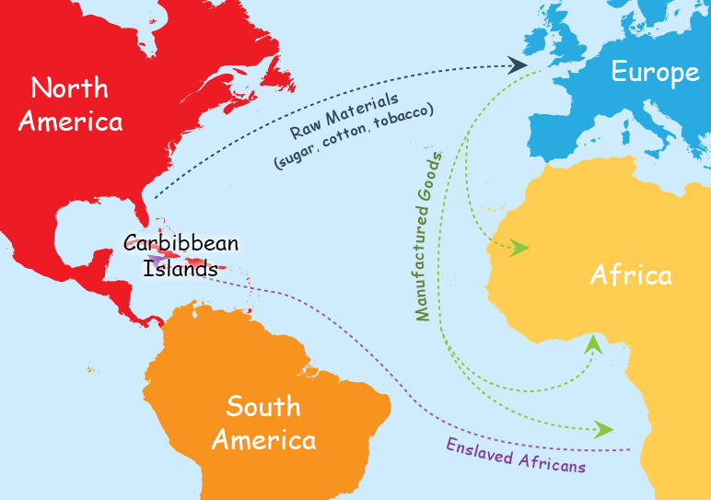
The Triangular Trade Route
The Triangular Trade Route was a pivotal aspect of the Transatlantic Slave Trade, involving Europe, Africa, and the Americas. This three-legged trade system began with European ships carrying manufactured goods to Africa, where they were exchanged for enslaved Africans. These enslaved individuals were then transported across the Atlantic (the harrowing Middle Passage) to the Americas, where they were sold. The ships then loaded with American products like sugar, cotton, and tobacco, returned to Europe. This trade cycle, driven by the demand for labor and goods, was crucial in the development of colonial economies but had devastating human costs.

Slide 5
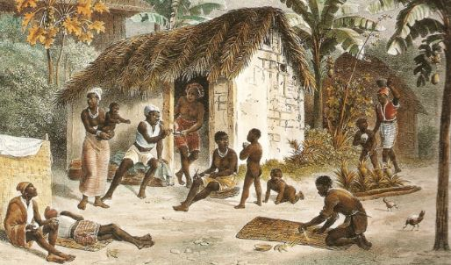
Life in Africa Before the Slave Trade
Before the Transatlantic Slave Trade, Africa was a continent rich in diversity, with flourishing societies and cultures. African civilizations boasted advanced political structures, ranging from powerful empires like Mali and Songhai to city-states and kingdoms. These societies had their own languages, religious beliefs, and traditions, reflecting a tapestry of cultural richness. Economically, Africans engaged in agriculture, metalworking, and trade both within the continent and with Europeans and Asians. Socially, communities were often organized around kinship and clan lines. This period was marked by intellectual achievements, vibrant art, and a deep connection to the land, showcasing a complex and thriving mosaic of life.

Slide 6
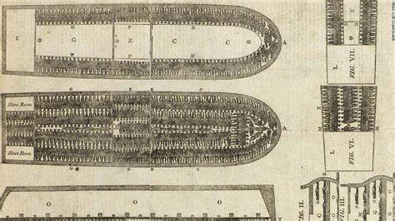
The Middle Passage
The Middle Passage refers to the harrowing sea voyage that transported enslaved Africans across the Atlantic Ocean to the Americas, a central element of the Transatlantic Slave Trade. This journey was notorious for its inhumanity and brutality. Enslaved Africans were confined in cramped, unsanitary conditions, leading to high mortality rates from diseases, malnutrition, and abuse. The passage, often lasting several weeks to months, was marked by suffering, with enslaved people enduring physical and psychological torment. The dehumanizing treatment aboard these ships exemplified the cruelty of the slave trade and left a lasting impact on the descendants of those who survived.

Slide 7
Long-Term Effects and Legacy
The Transatlantic Slave Trade had a big impact on Africa and America. In Africa, it caused a lot of people to be taken away as slaves, which messed up the way society worked. It also made it hard for Africa to develop economically and created long-lasting problems. In America, the arrival of enslaved Africans changed the culture, society, and economy a lot. It set the stage for racial inequalities that still exist today. Africans also added a lot to American culture through music, food, language, and religion. This painful history still affects how we talk about race, culture, and coming together today.

Slide 8
Effects in the Americas
The Transatlantic Slave Trade profoundly impacted American societies and economies, particularly in the United States, the Caribbean, and Brazil. It laid the foundation for plantation economies, with enslaved Africans being vital to the cultivation of cash crops like sugar, tobacco, and cotton, significantly boosting economic growth. However, it also entrenched racial hierarchies and systemic inequalities, with long-lasting social repercussions. The dehumanization of enslaved people led to a legacy of racial discrimination and social division. Culturally, African influences blended into local societies, significantly shaping music, cuisine, language, and religious practices, contributing to the rich tapestry of American cultural heritage.

Slide 9
Resistance and Abolition
People fought against the Transatlantic Slave Trade and slavery in many ways. Enslaved Africans often resisted by working slowly, damaging equipment, escaping, or even rising up in rebellions. A famous example is the Haitian Revolution, which created a free country. At the same time, many people in Europe and the Americas started to argue against slavery, forming groups to end it. Important figures like Frederick Douglass, Harriet Tubman, Olaudah Equiano, and William Wilberforce were crucial in this fight. They used their words and actions to challenge slavery, helping to end it legally in many places.

Slide 10
Conclusion
The Transatlantic Slave Trade, lasting from the 1500s to the 1900s, was a terrible time in history. It forced many Africans to move to the Americas, changing many lives and cultures deeply. This trade caused cruel treatment and started long-lasting racial problems that we still see today. Thinking about this time helps us understand big social and racial challenges we face. It shows why it's important to remember these wrongs. Doing so helps us learn and care more, aiming to fix past harms and build a fairer world.

