Slide 1
The Voyages of The Slave Ships
Diamond Gregory
HIST 374 Africa and the Atlantic Slave Trade
Professor Remi Alapo
York College

Slide 2
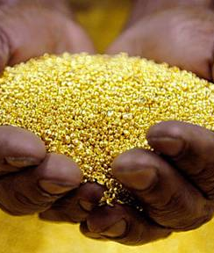
Africa Before Slavery
Africa was striving before slavery
People would travel for many days just to trade in Africa.
Kings and Queens would be covered in gold from head to toe
Because of its gold people wanted to explore Africa even more.

Slide 3
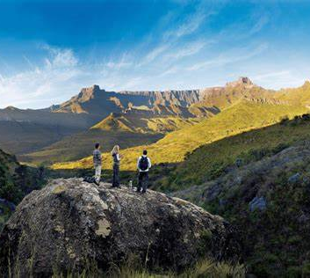
Portuguese in Africa
After King Mansa Musa returned from Mecca and helped build up Africa, that brought a lot of eyes to Africa. The Portuguese were the first Europeans to explore.
Vasco Da Gama discovered new sea routes that help explore more of the south of Africa, which made it possible to trade with India and China.

Slide 4
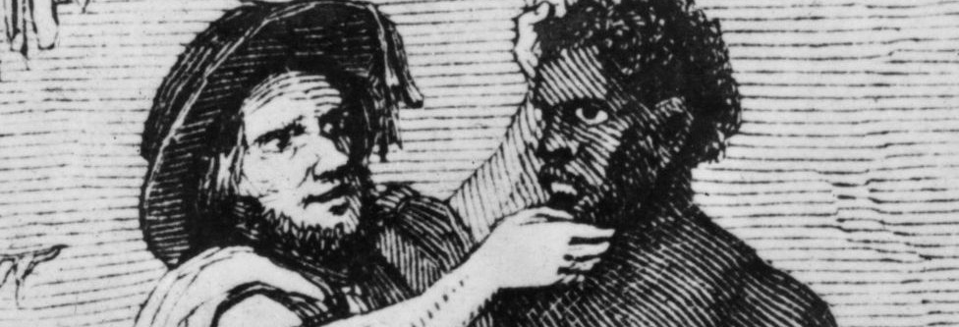
Trading Weapons for Slaves
shortage of labors to work on a plantation due to labor shortage. The Europeans had weapons that the Africans never seen never before, and they decided to trade with each other.

Slide 5
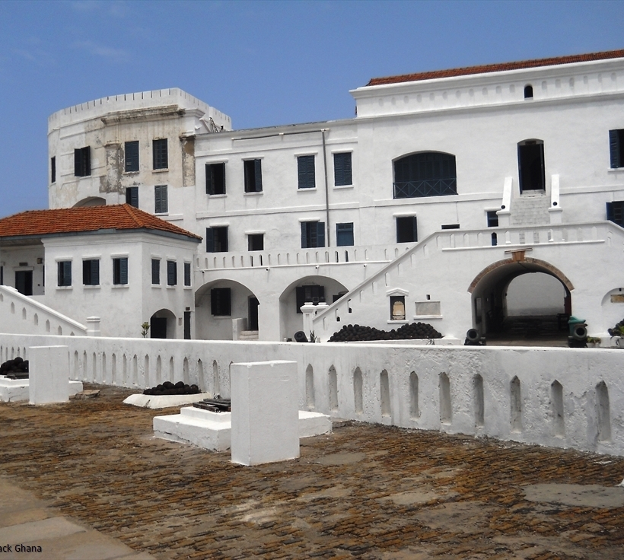
Castel Elmina
Located in Ghana, Castel Elmina was built in 1482. Purchase of slaves were held in Castel Elmina, with slave ships docked on the castle's port to transport slaves.
Before entering the ships slaves were strip and their hair was cut.

Slide 6
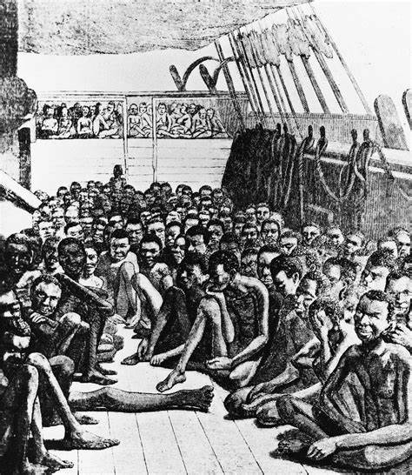
Life on the Slave Ships
Slaves were separated by gender. Men were separated from their family
Women were raped.
Diseases like smallpox, yellow fever, and measles. Many enslaves and ship crew died because of diseases spreading
Slaves would pray to die and would jump off the ships

Slide 7
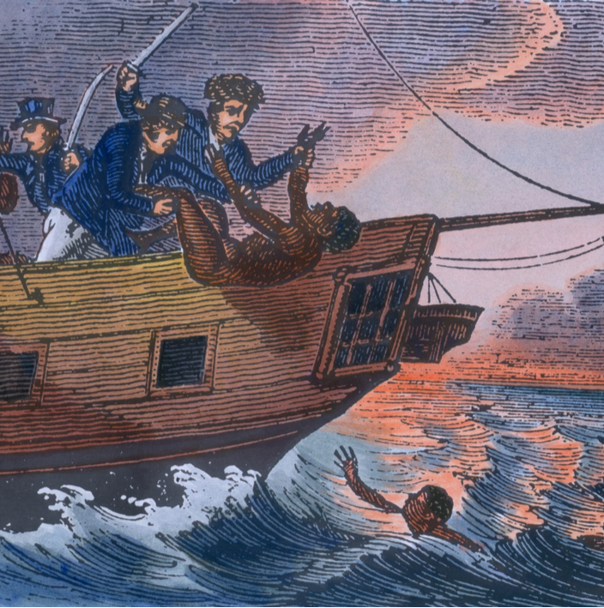
The Zong Massacre
In 1781 the slave ship the Zong left Ghana on its way to Black River in Jamaica. Because of navigation issues the voyage took longer causing the ship to run out of water. The crew deiced to overthrow some 130 slaves.

Slide 8
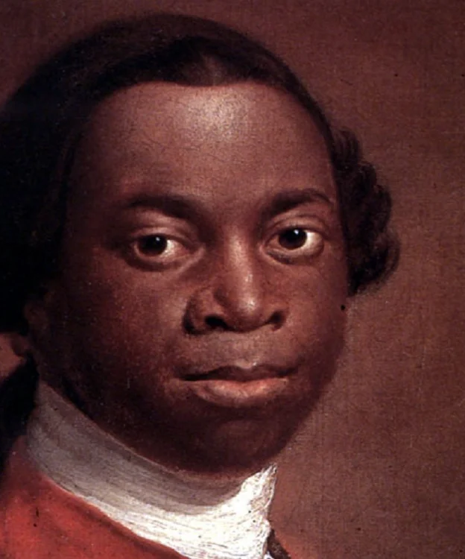
Olaudah Equiano A.K.A Gustavus Vassa
He spoke out against the slave trade.
A well known Abolitionist
Authored his own autobiography called “The Interesting Narrative of the Life of Olaudah Equiano”

Slide 9
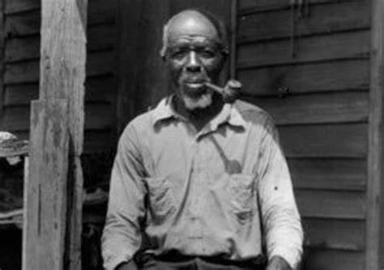
Cudjoe Lewis A.KA. Oluale Kossola
Kossola sailed on the last known slave ship called “ The Clotida” which sailed from Benin to Mobile, AL
Kossola was interviewed by Zora Neale Hurston who was an American author.
The interview was conducted in the 1930’s and wasn’t published until 2018.

Slide 10
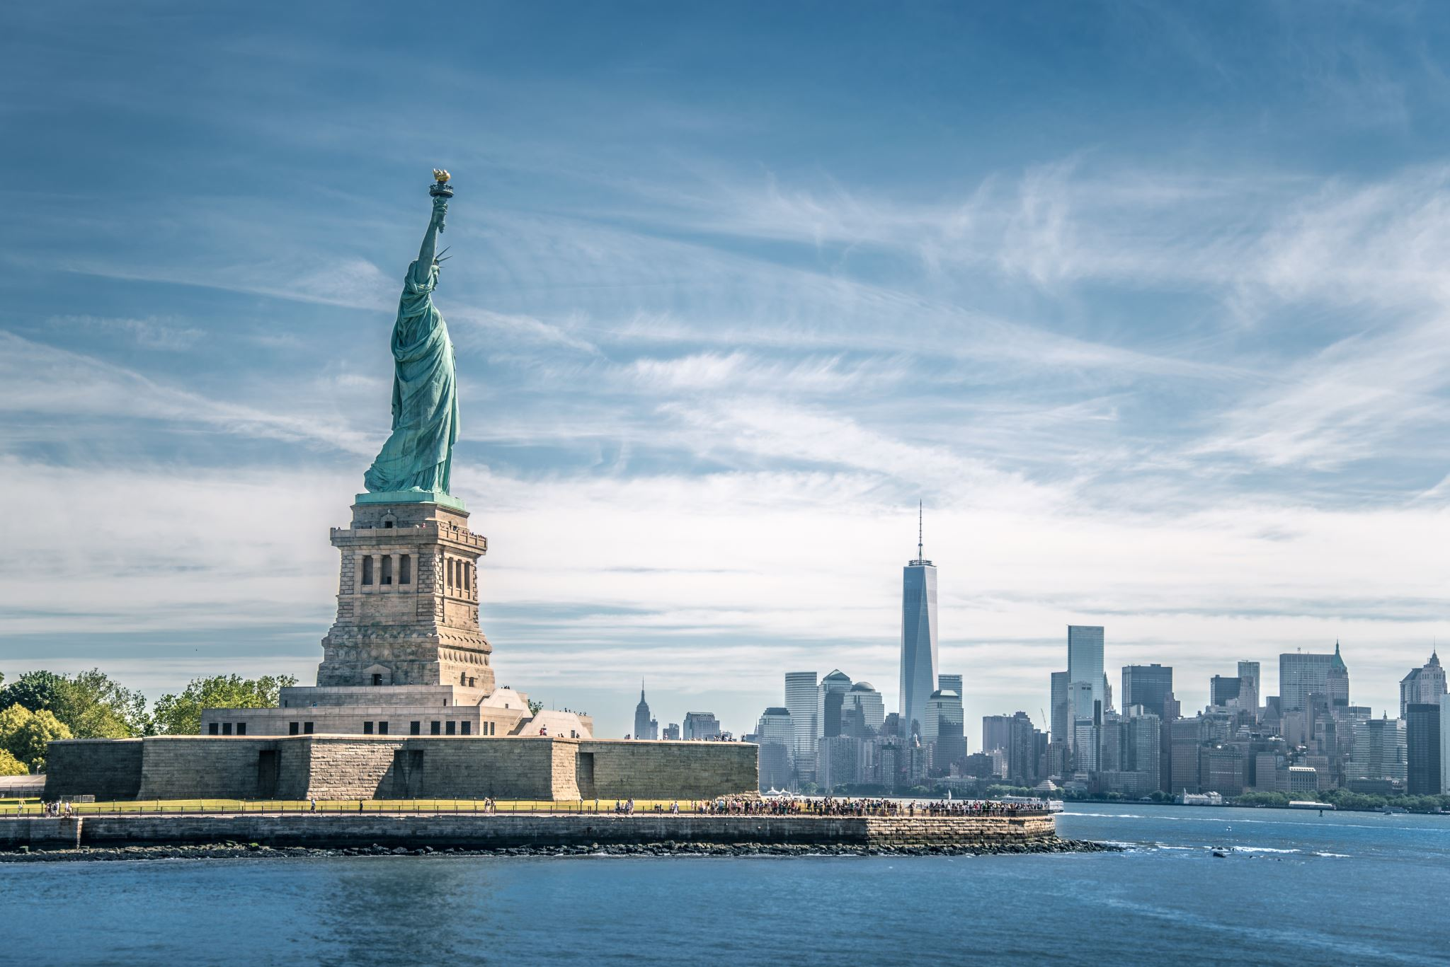
Slave Trade Act
Slave Trade Act was established 1807. The act was to help put a stop to transporting slaves from Africa to Britain and The New World “America”.
Although the law was in place, people were still transporting enslave illegally.

Slide 11
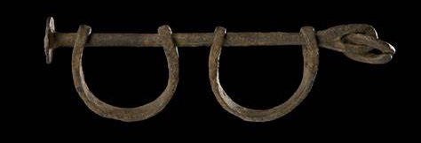
The Clotilda
The Clotilda set sail from Benin to Mobile, Al. The slave ship set sail in 1860, 50 years after the Slave Trade Act was set. According to research the ship carried 110 captive people. After arriving the Captain of the ship, William Foster decide to set the ship on fire so there would not be any evidence of the ship. Thanks to technology researchers and explorers are now able to find some artifacts from the sunken ship.

Slide 12
Thank You!!

